Slide 1
Permanent Deformation Characterization of Asphalt Mixtures Using Minimum Strain Rate, LVECD Program, and Triaxial Stress Sweep Test
Authors: Dahae Kim, Y. Richard Kim
Paper Number: 17-05785
Summary
  Demonstrate the ability of the Triaxial Stress Seep (TSS) test to evaluate the Minimum Strain Rate (MSR) of asphalt mixtures.
  Evaluate the rutting performance of the study mixtures using MSR mastercurves.
  Predict the rut depths of 16 pavement sections using the Layered ViscoElastic pavement analysis for Critical distresses (LVECD) program.
  Compare the predicted rut depths from the LVECD program to the field performance.
Poster Session Presentation: Tuesday, Jan 10, 1:30pm-3:15pm, Hall E/Convention Center

Slide 2
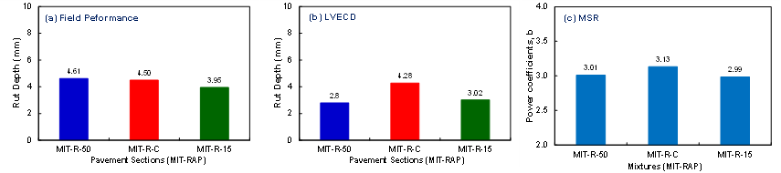
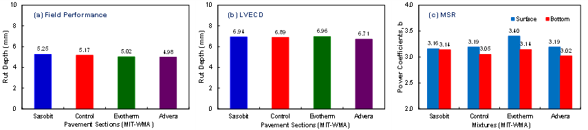
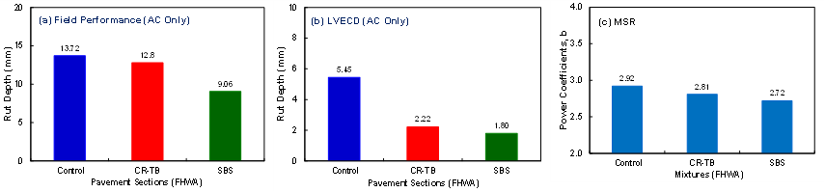
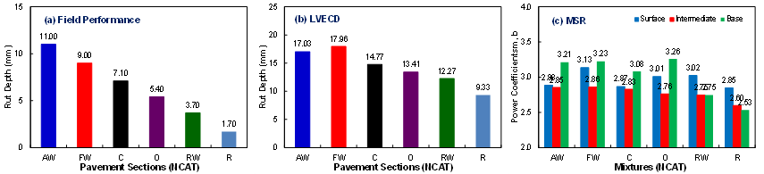
Permanent Deformation Characterization of Asphalt Mixtures Using Minimum Strain Rate, LVECD Program, and Triaxial Stress Sweep Test
Results

